Slide 1
Flappy Bird – Reinforcement Learning

Slide 2
Project description
Reinforcement Learning based approach to play Flappy Bird game.
Should be able to outperform an average human.

Slide 3
Our steps
Find the corresponding gymnasium environment
Apply the model from exercise to train
Failed to achieve results
Try out approaches from the internet on the same environment
Also failed
Use another environment with approach from the internet
Success

Slide 4
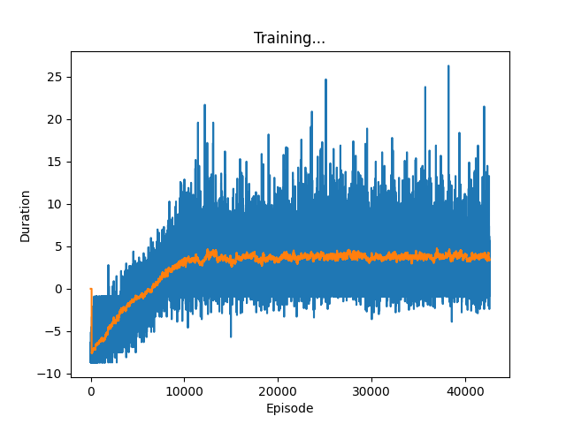
Results
The versions with the initial environment did not perform well
Probably because of how the environment works. Unfortunately we did not have enough time to research that issue deeper
Reward

Slide 5
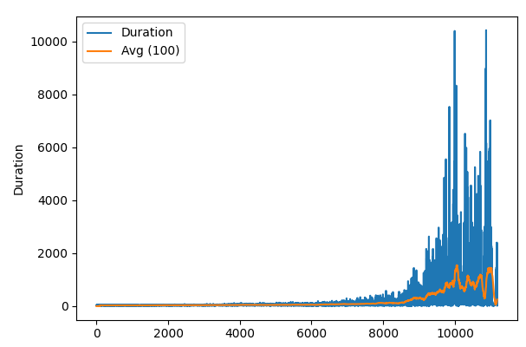
Results
Relatively good performance on the new environment
We applied DQN with slight modifications

Slide 6
Results
In the new environment:
Reward:
-5 for dying
+0.1 for taking any action
+1 for passing a pipe

Slide 7
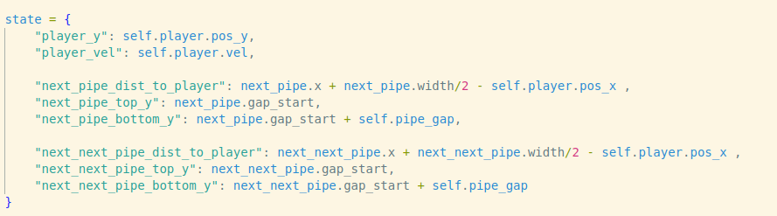
Results
In the new environment:
Notes:
player y position
players velocity
next pipe distance to player
next pipe top y position
next pipe bottom y position
next next pipe distance to player
next next pipe top y position
next next pipe bottom y position

Slide 8
Results
The final result needed around 4 hours to train on i5-7200u and gtx950m
Used Dueling Double DQN
Also uses Policy and Target Networks but calculates state value and action advantages
value
jump
calculated by the networks
state
advantages
advantages
no jump

